Slide 1

DIABETIC RETINOPATHY DETECTION USING CNN
THE NATIONAL INSTITUTE OF ENGINEERING, MYSURU
Department of Computer Science and Engineering
Submitted By :
Karuturi Chandini (4NI18CS030)
Sanjita V Nayak (4NI18CS076)
Sinchana K P (4NI18CS090)
Varsha Shivashankar (4NI18CS106 )
Guided By :
Mr. Suhas S
Assistant Professor
Dept of CS&E

Slide 2
AGENDA
Introduction
Existing System
Proposed System
Design
System Requirements
Algorithms implemented
Training the model
Conclusion
References

Slide 3
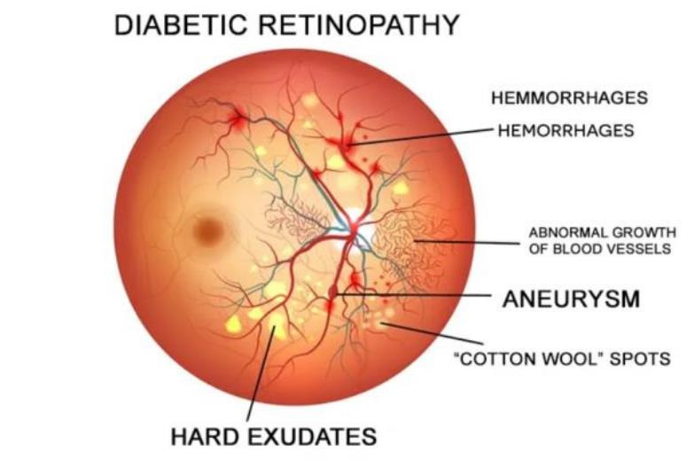
INTRODUCTION
Image Processing is widely used to diagnose the eye diseases in an easy and efficient manner.
It also supports Ophthalmologists to screen their patients and to do clinical study as well.
Digital fundus cameras are used to take the retinal vessel images.
Major eye related diseases that cause blindness worldwide
Diabetic Retinopathy
Glaucoma
age-related macular degeneration.

Slide 4

EXISTING SYSTEM
Currently, diagnosis and detection of Diabetic Retinopathy are done manually by trained and experienced clinicians. However, due to its nature, it is more error prone.
Early stages of signs and features of the retina can be difficult to observe raw images with processing.
Also, results and retinal images from a different source and from different patients may vary and that makes it even more difficult task and consume more time.
An automated solution to this problem can play a very important role in a real-life scenario. An automated system can detect Diabetic Retinopathy and determines its severity level with great precision from a variety of retinal images within less time.

Slide 5
PROPOSED SYSTEM
The basic input of the proposed system will be a fundus image that is produced after screening tests respectively. A fundus is a inner part of retina.
This Image then undergoes image pre-processing. This involves changing the images into the required or effective form for processing.
Pre-processing : Resizing the images and Noise Filtering
Then color space conversions and filtering techniques like Gaussian Filtering, Bilateral Filtering, Grey Scale Conversion are employed to convert the image into gray scale, reduced noise image respectively.
Firstly, the images are resized and sampled into the required size, say 224 X 224 if required.
After which edge detection methods and contouring techniques are used to outline the image properly.
Images are trained and tested for the results. Severity of the disease is identified for each image.

Slide 6
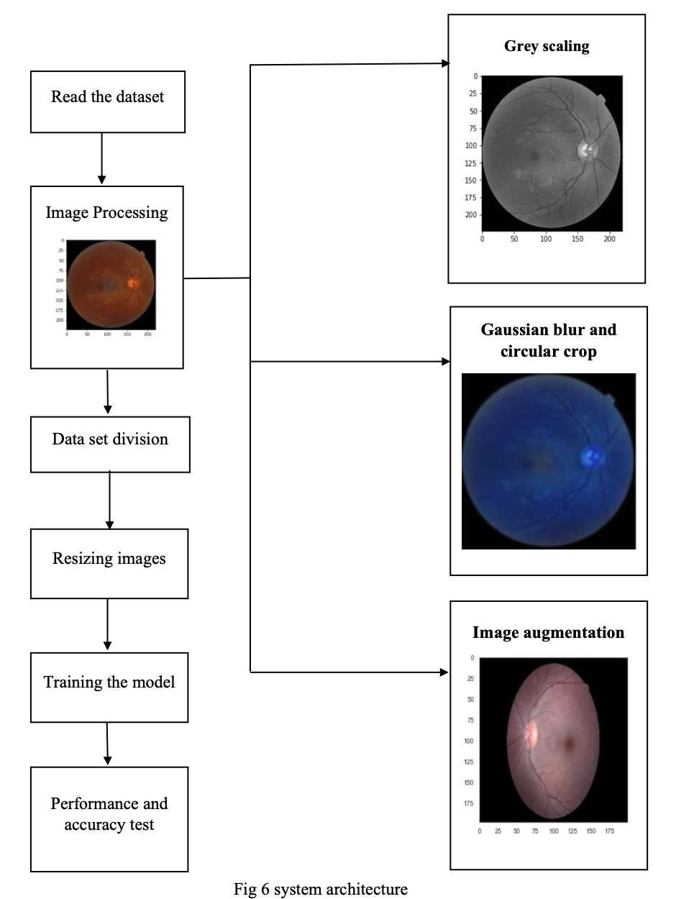
DESIGN
Resizing Images
SYSTEM ARCHITECTURE:
Divide dataset

Slide 7
SYSTEM REQUIREMENTS
SOFTWARE REQUIREMENTS
Dataset
Tools and Libraries
NumPy
Pandas
Keras
OpenCV
PIL
Matplotlib
ResNet 50

Slide 8
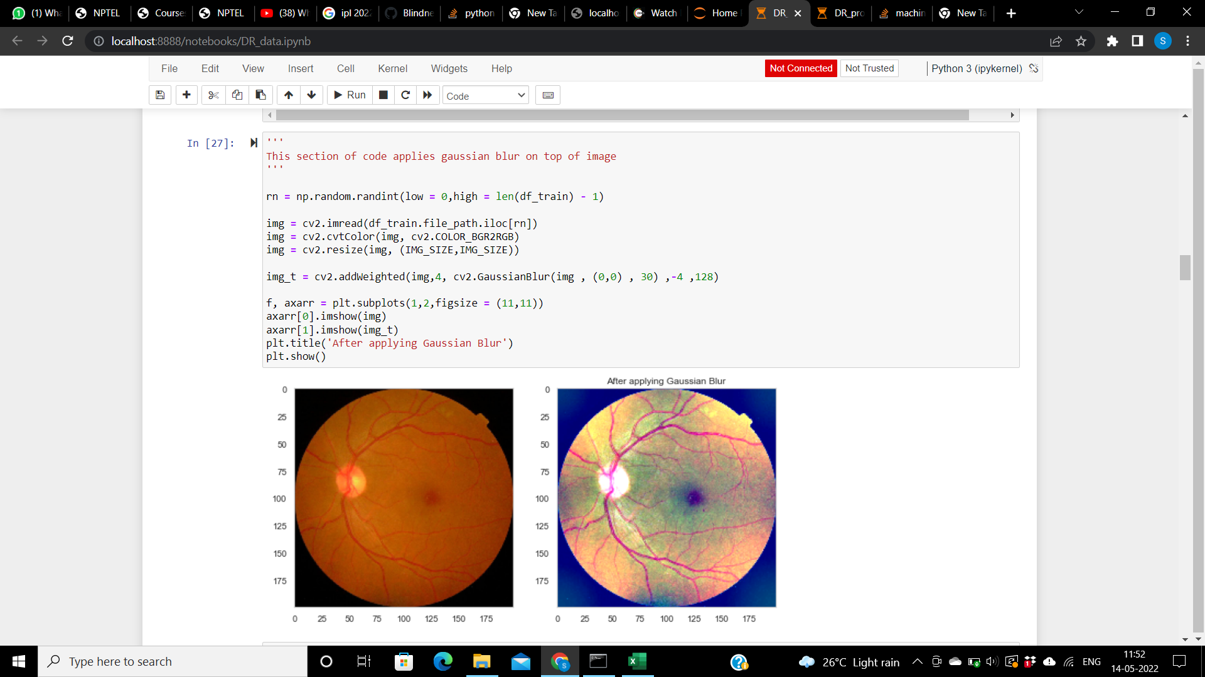
1.Gaussian blur
WORK DONE SO FAR
Algorithms implemented in the project

Slide 9
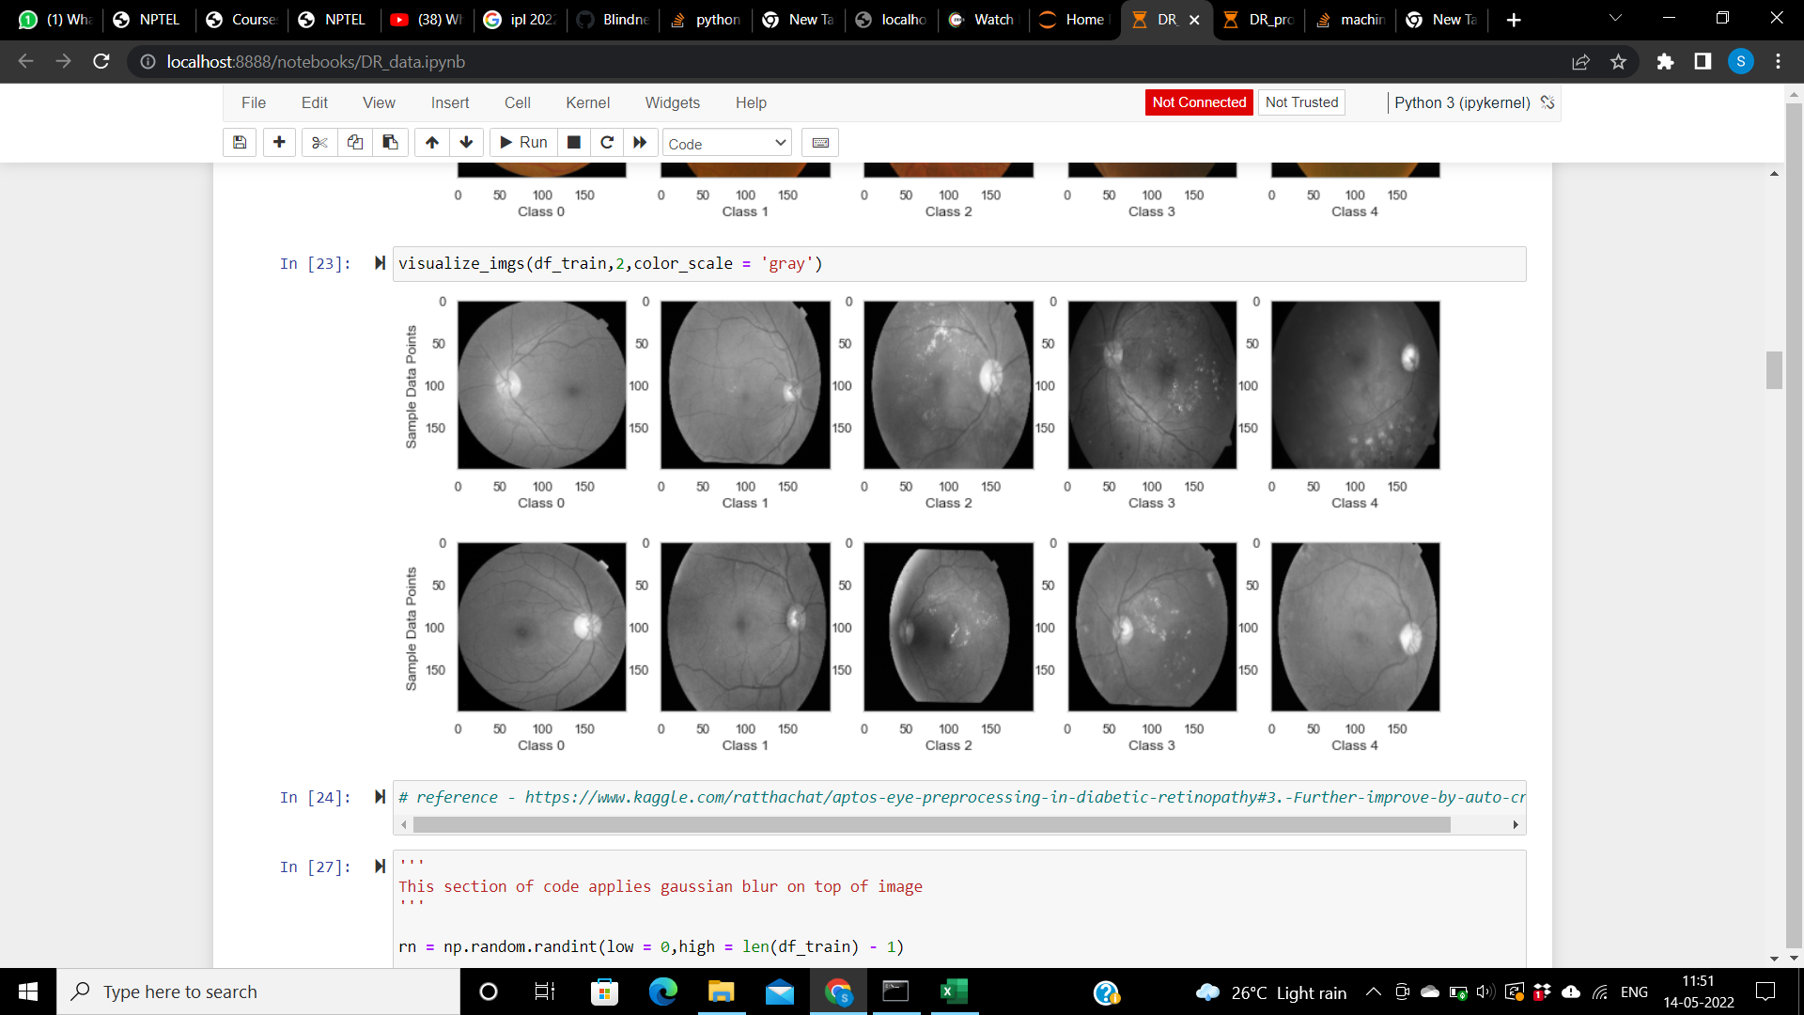
2. Grey scaling

Slide 10
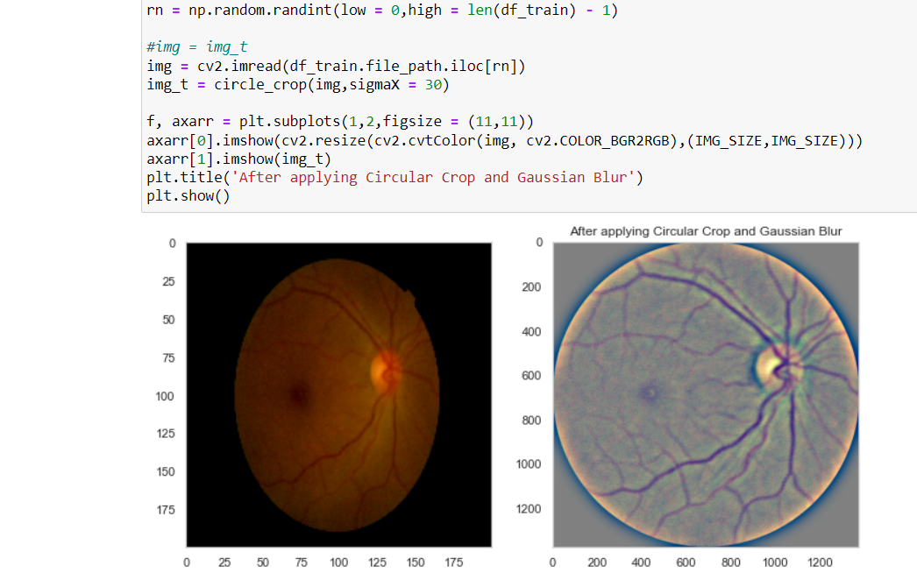
3. Circular crop

Slide 11
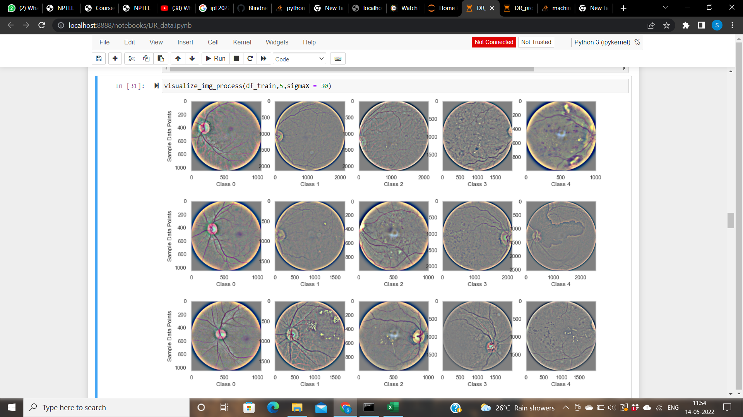
Applying all three filters to random images of each class

Slide 12
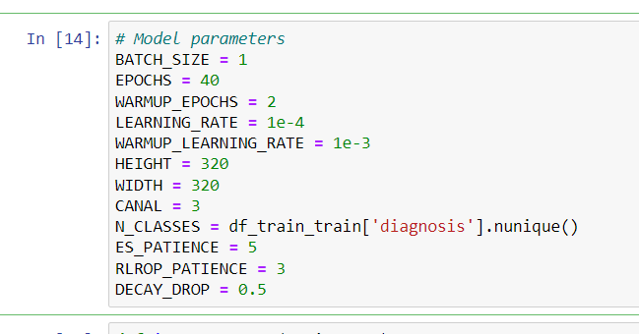
Training the model
Model: ResNet50
Activation functions: ReLU (Hidden layers)
Softmax (Last layer)
Loss functions: Categorial_crossentropy
Binary_crossentropy
Optimizer: Adam

Slide 13
ResNet50 Architecture
Layers :
Conv2D
Zeropadding2D
BatchNormalisation
Activation
MaxPooling2D
GolbalAveragePooling2D

Slide 14
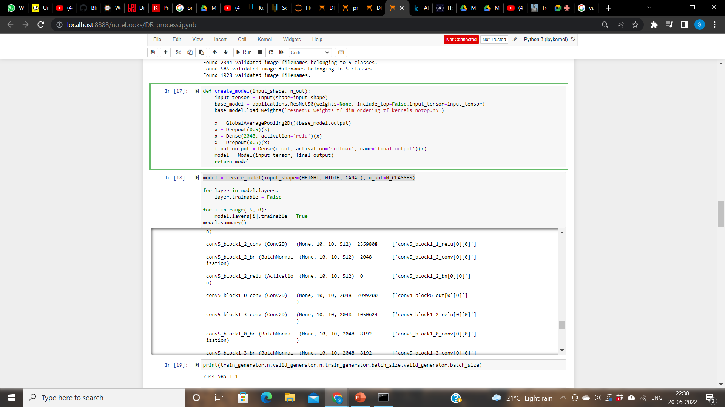

Slide 15
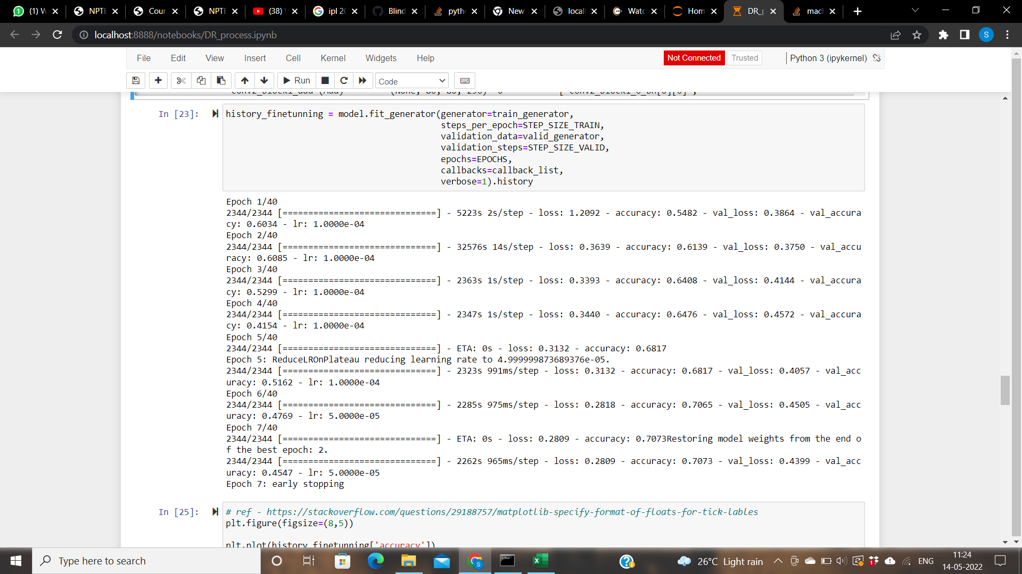
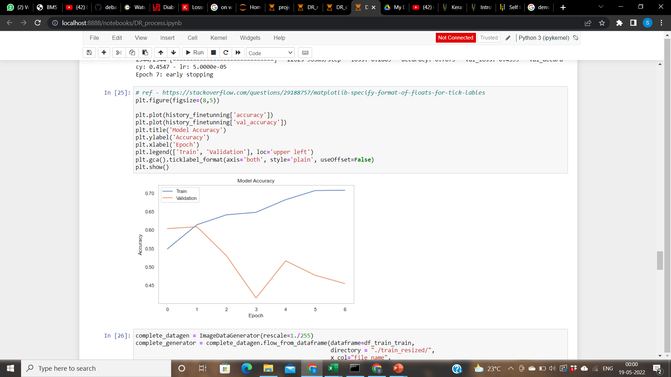

Slide 16
UPDATE
ResNet50 architecture was finalized
Model training
Model testing
Performance analysis

Slide 17
Architectures compared
ResNet50
ResNet101
EfficientNetB0

Slide 18
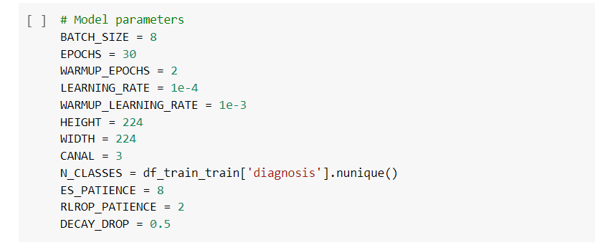
Model Parameters

Slide 19
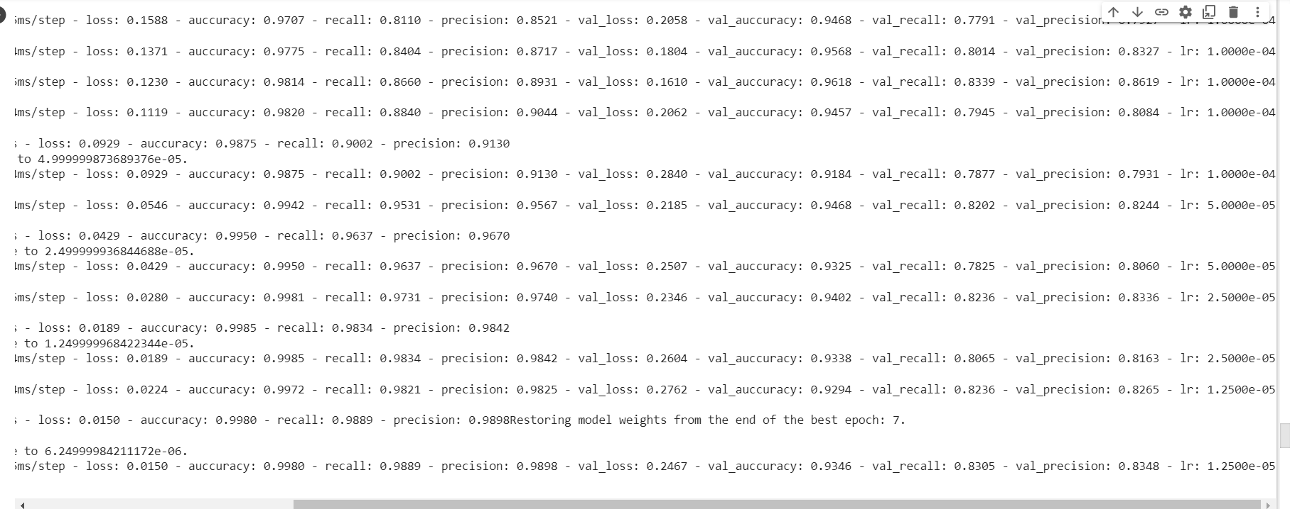
MODEL TRAINING

Slide 20
RESULTS
Accuracy: 0.9980
Recall: 0.9889
Precision: 0.9898
Loss: 0.0150
Validation Accuracy: 0.9346
Validation Recall: 0.8305
Validation Precision: 0.8348
Validation Loss: 0.2467

Slide 21
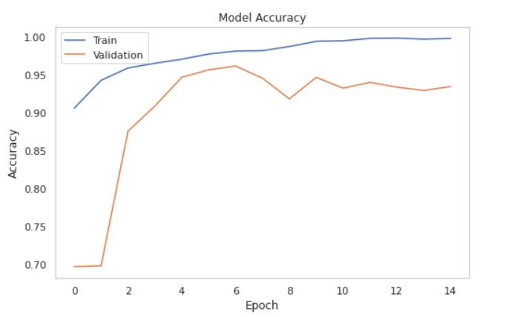
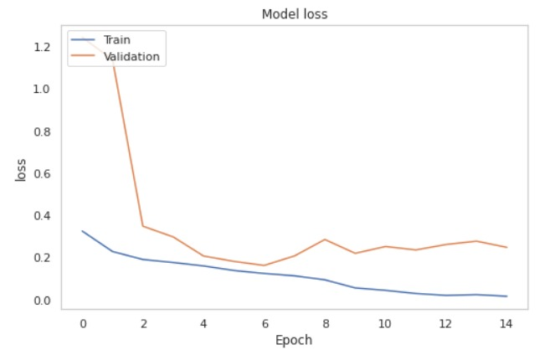
ACCURACY GRAPH
LOSS GRAPH

Slide 22
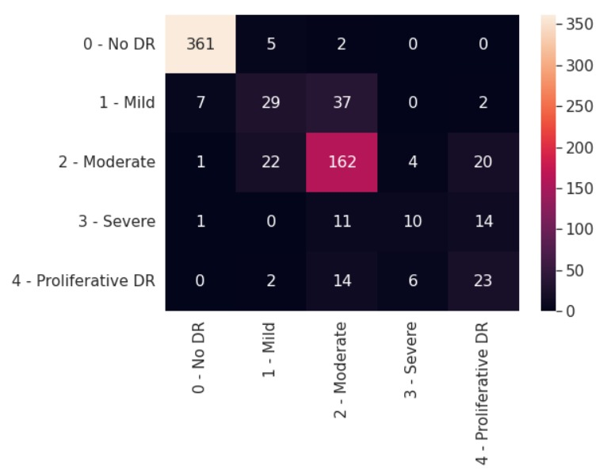
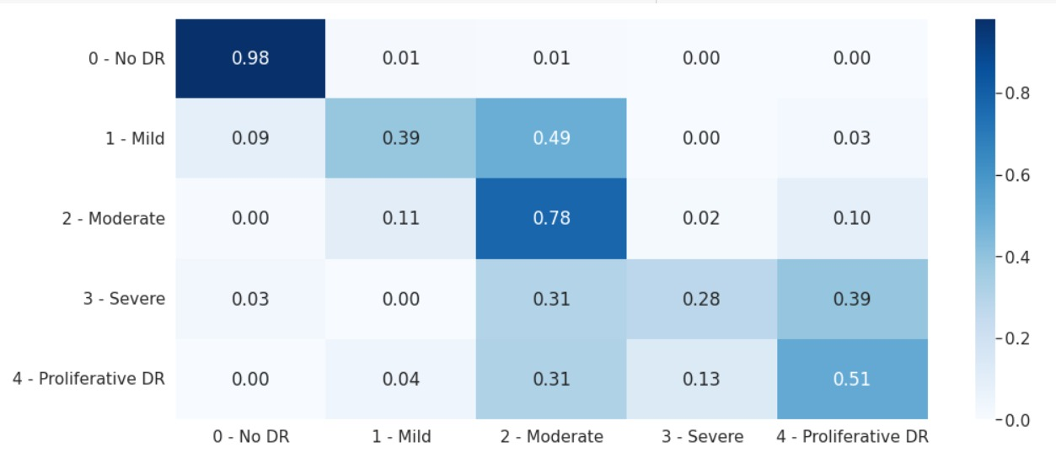
CONFUSION MATRIX

Slide 23
CONCLUSION
As a disease of vision impairment, Diabetic Retinopathy is a huge concern for patients with diabetes mellitus. Early detection is crucial and automated detection mechanisms with great accuracy in severity grading can be a great help for clinicians.
Therefore, this image processing- based classifier with such experimental performance can be considered a significant contribution.
In this project, use of several image processing techniques for Diabetic Retinopathy lesion detection are evaluated and implemented. It is found that early diagnosis of Diabetic Retinopathy can reduce the chance of vision loss up to 50%.

Slide 24
REFERENCES
[1] https://www.kaggle.com/c/aptos2019-blindness-detection/data
[2] https://www.ncbi.nlm.nih.gov/pmc/articles/PMC2911785/
[3] https://ieeexplore.ieee.org/document/8567055
[4] https://www.researchgate.net/publication/279530174_Diabetic_Retinopathy_Detection_ using_Image_Processing_A_Survey
[5] https://www.ijrte.org/wp-content/uploads/papers/v8i2S3/B10970782S319.pdf
[6] https://towardsdatascience.com/blindness-detection-diabetic-retinopathy-using-deep- learning-on-eye-retina-images-baf20fcf409e

Slide 25

Thank you

